Slide 1
From Polypharmacy to Deprescribing: A Wise Choice
Donna Bartlett PharmD, BCGP
donna.bartlett@mcphs.edu
June 2019

Slide 2
Presenter Disclosure Information
From Polypharmacy to Deprescribing: A Wise Choice Summary of Disclosure Information
None of the individuals in a position to control the content of this CME activity, and/or their spouse/partner have any relevant financial relationships with commercial interests to disclose.
The Massachusetts Medical Society has established procedures to identify and resolve any potential conflicts of interest (COI) prior to this educational activity. To ensure content objectivity, independence, fair balance and the alignment of the content with the interests of the public, any potential COI issues were resolved through content review.

Slide 3
Objectives
Define polypharmacy, how it can negatively affect the older population, including potential harms
Detect health issues that may be caused by multiple prescribed and over the counter medications; address these issues appropriately
Enumerate deprescribing opportunities including alternative therapies to medications to provide optimal prescribing

Slide 4
Choosing Wisely
Don’t use antipsychotics as the first choice to treat behavioral and psychological symptoms of dementia.
Avoid using medications other than metformin to achieve hemoglobin A1c <7.5% in most older adults; moderate control is generally better.
Don’t use benzodiazepines or other sedative-hypnotics in older adults as first choice for insomnia, agitation or delirium.
Don’t prescribe cholinesterase inhibitors for dementia without periodic assessment for perceived cognitive benefits and adverse gastrointestinal effects.
Don’t prescribe a medication without conducting a drug regimen review.

Slide 5
Polypharmacy
Add in a hospitalization
Multiple prescribers
Over the counter medications
Supplements and herbals
Multiple pharmacies
Multiple medications

Slide 6
Polypharmacy
Definition:
Multiple medications (4, 5, 6, 7, 8…)
Administration of unnecessary medications
Hutchinson, Sleeper 2010.

Slide 7
Polypharmacy
Risk Factors:
Demographics
Increased age, White, Educated
Health status
Poorer health, depression, HTN, anemia, asthma, angina, diabetes, gout, osteoarthritis
Access to healthcare
Number of healthcare visits, insurance, multiple providers
Hajjar/Hanlon 2007.

Slide 8
Polypharmacy Risks
Drug Interactions/Duplication
Adherence/Compliance Issues
Timing/Daily Drug Regimen
Appropriate Indication
Financial Difficulties
Geriatric Syndromes
Morbidity/Mortality
Hajjar/Hanlon 2007.

Slide 9
Suboptimal Dosing
Polypharmacy
Prescribing Cascade
Overuse
Underuse
Misuse
Questionable benefit
Complex regimens
Hajjar ER, Hanlon JT. Polypharmacy in elderly patients. The American Journal of geriatric Pharmacotherapy. 2007;5(4):345-351.

Slide 10
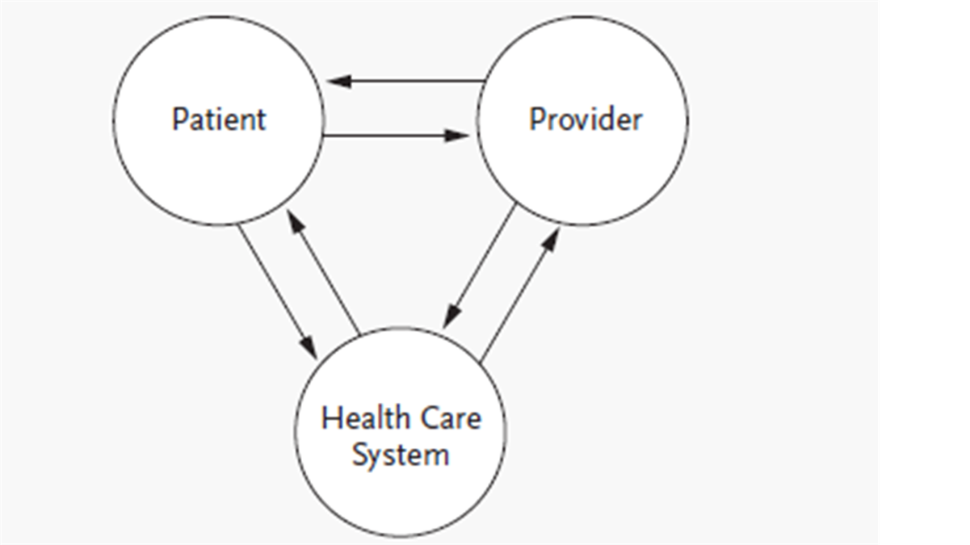
Who is Responsible for Adherence and Suboptimal Dosing?

Slide 11
Medication Appropriateness Index
Hutchinson LC, Sleeper RB. Polypharmacy and other forms of suboptimal drug use in older patients. In: Fundamentals of Geriatric Pharmacotherapy. ASHP. Bethesda, MD.2010:p.109-120.

Slide 12
If Polypharmacy is the disease/condition
then Deprescribing is the treatment/cure.
- Andrew Whitman, PharmD
D’Arrigo T. APhA Deprescribing is the cure for ‘disease’ of polypharmacy. November 27, 2018. https://www.pharmacist.com/article/deprescribing-cure-disease-polypharmacy .

Slide 13
Deprescribing Description
Stopping of medication
Decreased dose of medication
Changing a medication to a safer alternative
De-escalation of medication

Slide 14
Discontinuing Medications
Beers Criteria
STOPP and START
Screening Tool of Older People's Prescriptions (STOPP) and Screening Tool to Alert to Right Treatment (START)
Alternative meds
Taper or not?
All at once or one at a time?

Slide 15
TJ, 71yo male
Medication List:
Rosuvastatin 20mg one tablet daily
Niacin ER 500mg one tablet daily
Ezetimibe 10mg one tablet daily
Aspirin 81mg one tablet daily
Lisinopril 10mg one tablet daily
Pantoprazole 40mg one tablet daily
Is TJ a candidate for deprescribing?

Slide 16
Deciding when to stop meds
Review all medications
Identify risk of medications
Estimate life expectancy
Define care goals
Verify current indications
Determine need for preventative care
Determine benefit-harm of meds
Review/rank the meds according to need/usefulness
Identify drugs to target for discontinuation
Implement plan for discontinuation
Scott IA, Gray LC, Martin JH, et al. Deciding when to stop: towards evidence-based deprescribing of drugs in older populations. Evid Based Med 2013;18:121-124.

Slide 17
Determine Drug Utility
Strength of indication
Provides immediate relief
Effective for an acute condition
Effective for a chronic condition
Has potential to prevent serious disease
Unlikely useful in short or long term use
A non-drug therapy could be used
Likelihood of misuse, toxicity, non-adherence
Little benefit with high risk of toxicity
Duplicate therapy
Prescribed for adverse drug reaction (prescribing cascade)
Risk of drug-drug or drug-disease interactions
Multiple doses per day
Could be provided as a combined medication
Causing adherence issues
Scott IA, Gray LC, Martin JH, et al. Deciding when to stop: towards evidence-based deprescribing of drugs in older populations. Evid Based Med 2013;18:121-124.

Slide 18
Deciding when to stop meds
Meds that require slow discontinuation
Cardiovascular
Anticonvulsants
Antidepressants
Antipsychotics
Anticholinergics
Benzodiazepines
Corticosteroids
Digoxin
Diuretics
Narcotics
NSAIDS
(and….PPIs)
Scott IA, Gray LC, Martin JH, et al. Deciding when to stop: towards evidence-based deprescribing of drugs in older populations. Evid Based Med 2013;18:121-124.

Slide 19
PPI Deprescribing
Continuation of use despite indication
Inappropriate initiation
No clear indication for continuation post-hospital discharge
Concerns to stop medications others have prescribed
Concerns of long-term use:
Chronic and acute kidney disease
C. diff
Pneumonia
Hypomagnesaemia
Fracture risk

Slide 22
Mindful Deprescribing
M | Medical History
I | Identify Potentially Inappropriate Medications
N | Negate PIMs through evidence and patient criteria
D | Document decision and rationale
F | Follow up with the patient
U | Understanding of changes by the patient
L | List current medications on a new medication list for the patient
Jetha S. Polypharmacy, the elderly, and deprescribing. The Consultant Pharmacist. 2015;30(9):527-532.

Slide 23
TJ
You decide he is a candidate for deprescribing.
What medications, how would you deprescribe using the MINDFUL approach?
Medication List:
Rosuvastatin 20mg one tablet daily
Niacin ER 500mg one tablet daily
Ezetimibe 10mg one tablet daily
Aspirin 81mg one tablet daily
Lisinopril 10mg one tablet daily
Pantoprazole 40mg one tablet daily

Slide 24
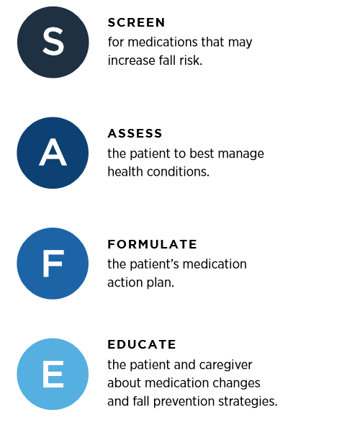
https://www.cdc.gov/steadi/pdf/STEADI-FactSheet-SAFEMedReview-508.pdf

Slide 25
EMPOWER
Eliminating Medications Through Patient Ownership of End Results
50% MDs continue to prescribe benzodiazepines due to patient dependence and benefit
Direct to consumer patient education and empowerment including visual diminishing schedule
Watch what is being substituted
27% of intervention group vs 5% of control group
Tannenbaum C, Martin P, Tamblyn R. Reduction of inappropriate benzodiazepine prescriptions among older adults through direct patient education The EMPOWER cluster randomized trial. JAMA Intern Med. 2014;174(6):890-898.

Slide 26
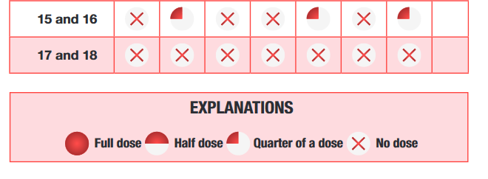
EMPOWER Tapering Schedule
http://www.criugm.qc.ca/fichier/pdf/BENZOeng.pdf

Slide 27
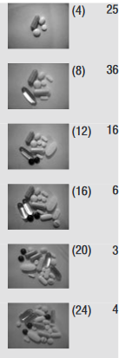
PATD Questionnaire
People’s Attitudes Towards Deprescribing
15 questions including:
I am taking a large amount of meds
I am comfortable with the number of meds
I think my meds are necessary
If MD approved, I would stop one or more meds
I would like to reduce my meds
I think I am taking meds that are no longer necessary
I think I need more meds
I would like to pay less for meds by reducing the number
I think I have side effects due to my med(s)
How many is too many?
What is the max you would like to take (pictorial)*
Would you like a pharmacist to work with you
What follow-up would you like if you stopped a med
Reeve E, Wiese MD, Hendrix I, et al, People’s attitudes, beliefs, and experiences regarding polypharmacy and willingness to deprescribe. Journal of American Geriatrics Society. 2013;1(9):1508-1514.

Slide 28
PATD (cont.)
High percentage: 90% were willing to try stopping a medication if appropriate
This high percentage varied when looking at other studies that were targeting certain medications
Example: antihypertensive (80%) versus benzodiazepine (33%) depends upon true acceptance if left to a patient’s final decision to stop medication
Reeve E, Wiese MD, Hendrix I, et al, People’s attitudes, beliefs, and experiences regarding polypharmacy and willingness to deprescribe. Journal of American Geriatric Society. 2013;1(9):1508-1514.

Slide 29
Deprescribing in the hospital setting
Reasons for Discontinuation:
No valid indication
Time of life expectancy less than benefit of medication
Risk of harm
No symptom relief
Symptoms resolved
Unacceptable treatment burden
McKean M, Pillans P, Scott IA. A medication review and deprescribing method for hospitalised older patients receiving multiple medications. Internal Medicine Journal. 2016;46(1):35-42.

Slide 30
Medications to Consider
Benzodiazepines
PPI
SSRI –fluoxetine, paroxetine, citalopram
Gabapentin
Anticholinergic agents
NSAIDs
Bisphosphonates
Supplements and Vitamins

Slide 31
IA
IA 63 year old Caucasian female
On admission: Recurrent falls, depression, fatigue, poor sleep, QT prolongation
Medications
Fluoxetine 40mg daily- Patient increased to 80mg daily
Levothyroxine 100mcg daily – sub-therapeutic (TSH 17uIU/mL)
Albuterol HFA 90mcg with spacer 2 puffs as needed for wheezing
Budesonide-formoterol inhaler 160-4.5mcg 2 puffs bid
Omeprazole 20mg daily for > 1 year for GERD
Levetiracetam 500mg bid
Quetiapine 50mg evening

Slide 32
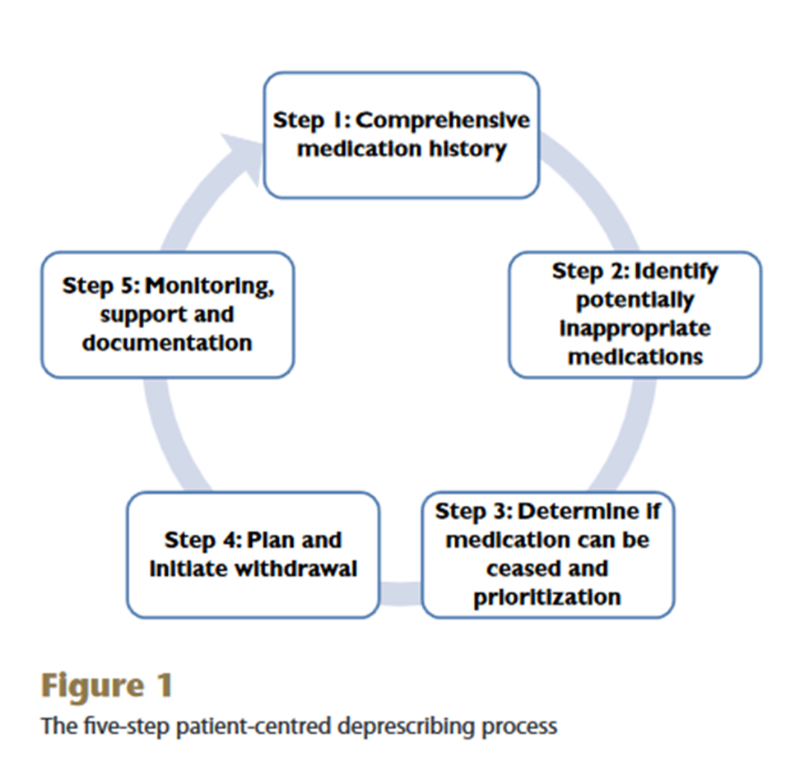
Reeve E, Shakib, S, Hendrix I, et al. Review of deprescribing processes and development of an evidence-based, patient-centred deprescribing process. Br J Clin Pharmacol. 2014 Oct;78(4):738-47.

Slide 33
IA Medications
Deprescribed:
Quetiapine 50mg –discontinued due to QT Prolongation
Fluoxetine-reduced to 40mg daily
Added:
Melatonin 3mg take 2 every evening-in hospital
Magnesium oxide 400mg daily-hypomagnesemia
Unchanged:
Albuterol HFA 90mcg with spacer 2 puffs as needed for wheezing
Budesonide-formoterol inhaler 160-4.5mcg 2 puffs bid
Omeprazole 20mg daily for > 1 year for GERD-potential inappropriate continued use
Levetiracetam 500mg bid-neurology follow-up for myoclonus
Changed:
Levothyroxine 125mg daily (increase)

Slide 34
Deprescribing is a PROCESS
Patient care goals
Level of function
Life expectancy
Values
Preferences
McGrath K, Hajjar ER, Kumar C, Hwang C, Salzman B. Deprescribing: A simple method for reducing polypharmacy. The Journal of Family Practice.2017;66(7):436-445.

Slide 35
Question 1
How many times over the past month have you deprescribed a medication?
Too many to count
At least once a week
Once or twice
Not at all this month but have in the past
None
Thought: Opportunities to deprescribe can happen at every encounter.
McGrath K, Hajjar ER, Kumar C, Hwang C, Salzman B. Deprescribing: A simple method for reducing polypharmacy. The Journal of Family Practice.2017;66(7):436-445.

Slide 36
Patient Barriers to Deprescribing
Fear that condition may worsen
Lack of suitable alternative if needed
How will the condition be managed
Previous poor experience of medication stopped
Caregivers do not agree
Hoping for effectiveness or change in condition
Feelings of being “given-up on”
McGrath K, Hajjar ER, Kumar C, Hwang C, Salzman B. Deprescribing: A simple method for reducing polypharmacy. The Journal of Family Practice.2017;66(7):436-445.

Slide 37
Discussion with Patients
Some medications you take may be having an additive effect
Because our bodies change as we age (just like when we are children) we may need to adjust some medications
Some medications you take may be contributing to ….
Falls
Memory loss
Incontinence
Farrell B, Mangin D. Deprescribing is an essential part of good prescribing. American Family Physician. 2019;99(1).

Slide 38
Discussion with Patients
You may have tried stopping this medication before, but it needs to be tapered slowly, lets try to reduce the dose and see
Let’s do this slowly and follow up
Because you no longer need this medication, you will no longer need to take the…(prescribing cascade medication)
Diuretic and potassium
Diuretic and incontinence medication
This will lessen the amount of medications you are taking and having to pay for
Farrell B, Mangin D. Deprescribing is an essential part of good prescribing. American Family Physician. 2019;99(1).

Slide 39
Question 2
How likely are you to consider a recommendation, from a pharmacist, to deprescribe a medication for your patient?
Very likely
Possibly likely
Would need to see the patient first
Unlikely

Slide 40
Question 3
How likely are you to consider deprescribing a medication, initiated by another provider?
Very likely
Possibly likely
Would call the provider first
Unlikely
Definitely would not

Slide 41
Prescriber Barriers to Deprescribing
Contradicting other prescribers (specialists)
Fear of withdrawal symptoms or relapse
Unclear benefits versus risk
Difficult to approach life-expectancy conversations
Patient thoughts that care is being “downgraded”
Time to deprescribe
“Easier” to continue
McGrath K, Hajjar ER, Kumar C, Hwang C, Salzman B. Deprescribing: A simple method for reducing polypharmacy. The Journal of Family Practice.2017;66(7):436-445.

Slide 42
Deprescribing is Good Prescribing
Allows for patient education
Changes of ADME
Additive adverse effects
Update treatment goals
Allows for patient-centered approach to care
Good review of “legacy prescribing” –medications not necessarily meant to be continued indefinitely
Take a “Pause and monitor” approach
Document outcomes
Farrell B, Mangin D. Deprescribing is an essential part of good prescribing. American Family Physician. 2019;99(1).

Slide 43
Question 4
How would you approach someone who asked you about deprescribing?
Initiate a conversation immediately
Schedule another appointment
Ask a pin-point question about which medication they wanted to know about
Or state, “If you are not having any issues then there is no need to review”

Slide 44
Question 5
Do you currently have a method/step-by-step approach to deprescribing that you use in your practice?
Yes
Kind of, maybe
No, not really
If so, how well is this communicated during transitions of care?
Know, there is no “Gold Standard” to deprescribe.
McGrath K, Hajjar ER, Kumar C, Hwang C, Salzman B. Deprescribing: A simple method for reducing polypharmacy. The Journal of Family Practice.2017;66(7):436-445.

Slide 45
Potential Benefits of Deprescribing
Fewer falls
Improved cognition
Improved quality of life
No adverse drug reactions
Decrease in health care costs
Reduced drug interactions
Increased patient satisfaction
McGrath K, Hajjar ER, Kumar C, Hwang C, Salzman B. Deprescribing: A simple method for reducing polypharmacy. The Journal of Family Practice.2017;66(7):436-445.

Slide 46
Wise Challenge
Choosing Wisely #9:
Don’t prescribe a medication without conducting a drug regimen review.
Challenge:
Don’t CONTINUE a medication without conducting a drug regimen review.

Slide 47
Wrap Up
Review polypharmacy in an older adult, consider employing the Medication Appropriateness Index and deprescribing as a potential treatment/cure
Apply a step-by-step process and rationale to the discontinuation of medications based on falls risk, suboptimal dosing, and polypharmacy concerns; include follow-up and document changes.
Promote optimal medication use and appropriate deprescribing while considering the patient’s attitude and empowerment, and
Favorite article if you want to read further:
Steinman MA, Hanlon JT. Managing medications in clinically complex elders “There’s got to be a happy medium”. JAMA. 2010;304(14):1592-1601.

Slide 48
Thank you!
Questions?
donna.bartlett@mcphs.edu

Slide 49
References
Ailabouni NJ, Nishtala PS, Mangin D, Tordoff JM. Challenges and enablers of deprescribing: a general practitioner perspective. PLoS ONE.2016;11(4):e0151066.
Ten things Clinicians and Patients Should Question. American Geriatrics Society. Revised April 23, 2015. https://www.choosingwisely.org/wp-content/uploads/2015/01/Choosing-Wisely-Recommendations.pdf
Hutchinson LC, Sleeper RB. Polypharmacy and other forms of suboptimal drug use in older patients. In: Fundamentals of Geriatric Pharmacotherapy. ASHP.Bethesda,MD.2010:p.109-120.
D’Arrigo T. APhA. Deprescribing is the cure for ‘disease’ of polypharmacy. November 27, 2018. https://www.pharmacist.com/article/deprescribing-cure-disease-polypharmacy .
Hajjar ER, Hanlon JT. Polypharmacy in elderly patients. The American Journal of geriatric Pharmacotherapy. 2007;5(4):345-351.
American Geriatrics Society 2015 updated Beers Criteria for potentially inappropriate medication use in older adults. NGC:010857 2015 Nov. https://www.guideline.gov/summaries/summary/49933/american-geriatrics-society-2015-updated-beers-criteria-for-potentially-inappropriate-medication-use-in-older-adults Accessed:February 12, 2018.
Gallagher PF, O’Connor MN, O’Mahony D. Prevention of potentially inappropriate prescribing for elderly patients: a randomized controlled trial using STOPP/START criteria. Clinical Pharmacology & Therapeutics. 2011;89(6):845-854.
Scott IA, Gray LC, Martin JH, et al. Deciding when to stop: towards evidence-based deprescribing of drugs in older populations. Evid Based Med 2013;18:121-124.

Slide 50
References
Deprescribing Guidelines and Algorithms. https://deprescribing.org/resources/deprescribing-guidelines-algorithms/. Accessed February 12, 2018.
Jetha S. Polypharmacy, the elderly, and deprescribing. The Consultant Pharmacist. 2015;30(9):527-532.
SAFE Fact Sheet. https://www.cdc.gov/steadi/pdf/STEADI-FactSheet-SAFEMedReview-508.pdf . Accessed June 14, 2019.
Tannenbaum C, Martin P, Tamblyn R. Reduction of inappropriate benzodiazepine prescriptions among older adults through direct patient education The EMPOWER cluster randomized trial. JAMA Intern Med. 2014;174(6):890-898.
Reeve E, Wiese MD, Hendrix I, et al, People’s attitudes, beliefs, and experiences regarding polypharmacy and willingness to deprescribe. JAGS. 2013;1(9):1508-1514.
Galazzi A, Lusignani M, Chiarelli MT, et al. Attitudes towards polypharmacy and medication withdrawal among older inpatients in Italy. Int J Clin Pharm. 2016;38:454-461.

Slide 51
References
Reeve E, Shakib, S, Hendrix I, et al. Review of deprescribing processes and development of an evidence-based, patient-centred deprescribing process. Br J Clin Pharmacol. 2014 Oct;78(4):738-47.
Farrell B, Mangin D. Deprescribing is an essential part of good prescribing. American Family Physician. 2019;99(1).
McGrath K, Hajjar ER, Kumar C, Hwang C, Salzman B. Deprescribing: A simple method for reducing polypharmacy. The Journal of Family Practice.2017;66(7):436-445.

